Slide 1
Machine Learning – Principal Component Analysis(PCA)

Slide 2

Roadmap
What is PCA?
Applying PCA
Steps to perform PCA

Slide 3

Why PCA?

Slide 4
Problem Statement
Imagine you had a dataset with 1000 features.
To visualize all these features and to try to explain the relationships between these features would be a nightmare.
Moreover, your model runs the risk of Overfitting. Overfitting in simple terms means that your model has memorized your dataset patterns too much such that it does not perform well when given new data.

Slide 5
Pre-requisite
The number of features in a dataset is referred to as its dimensionality.
Therefore a dataset with a lot of features is said to be high-dimensional and a dataset with a small number of features is said to be low-dimensional.
Therefore to solve our problem statement above, what we need to do is transform a highly dimensional dataset into a low dimensional data set.
This is called dimension reduction.
Please note that dimension reduction is not deleting the columns. It is mathematically transforming information in your columns to capture the same exact information, but using fewer columns. For instance, if you had two highly correlated features, you can combine them into a new feature

Slide 6
Benefits of Dimension Reduction
Consumption of less computational resources.
Faster running models.
Improvement of your model performance.
Better Data Visualization.
One of the most popular techniques that helps us with dimension reduction is Principal Component Analysis(PCA).

Slide 7
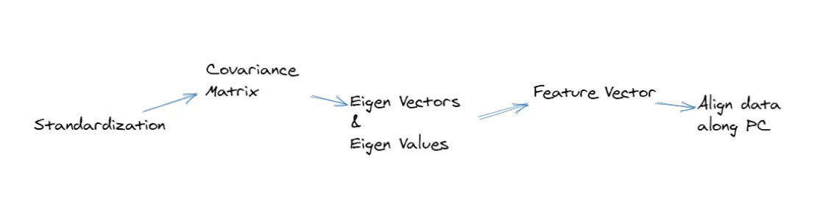
Steps to perform PCA
Standardization
Covariance Matrix
Eigen Decomposition
Sort By Eigen Values
Choose your Principal Components

Slide 8
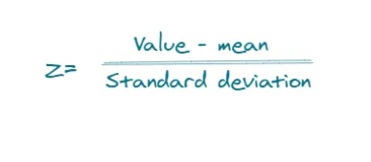
Standardization
When analyzing data we deal with datasets whose features greatly vary in magnitude and units.
For instance, you could be dealing with features measured in kgs, km, grams, cms, etc.
By applying machine learning techniques to these features as they are, then your algorithm, for instance, would consider 100grams to be greater than 1kg which is not true and our algorithm will give us wrong predictions
We, therefore, need to come up with a way to standardize our features before applying any algorithm to them.
This means therefore when dealing with variables such as weight(0–10000grams), age(0–100 years), and salary(0–8000 Usd), feature scaling would standardize them to be in the same range, for example, range (0,1) depending on the scaling technique used

Slide 9
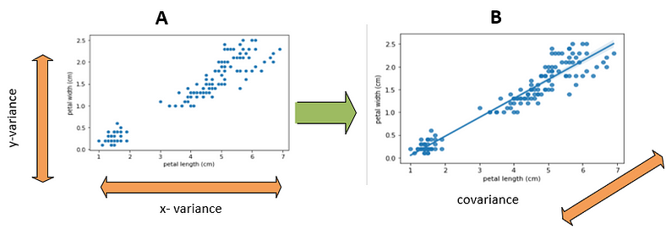
Covariance Matrix
Variance — measures how much your data is spread out. Covariance — this is a measure that describes the relationship between variables

Slide 10
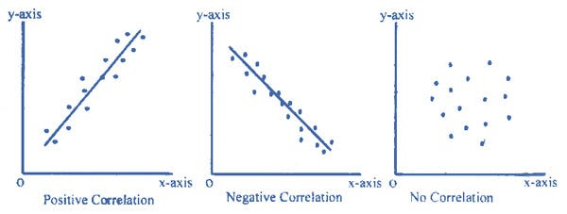
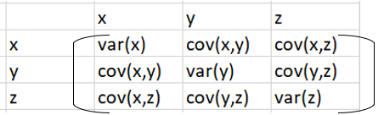
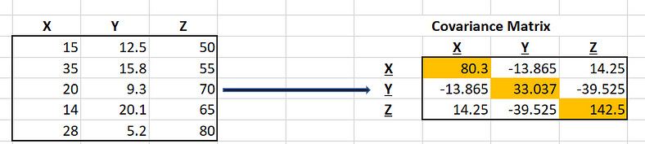
Covariance Matrix
Variance — measures how much your data is spread out. Covariance — this is a measure that describes the relationship between variables

Slide 11
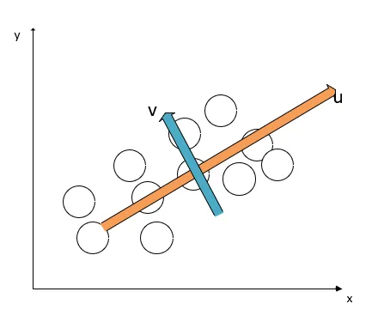
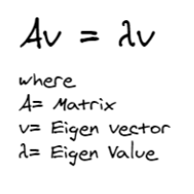
Eigen Decomposition
If you had a two-dimensional dataset as shown below then you would have two vectors u and v .In order of hierarchy, u would be considered your first vector(direction in which the data varies the most)and v the second vector( direction of greatest variance among those that are perpendicular) to the first eigenvector.

Slide 12
Eigen Decomposition
Process of producing eigenvalues and eigenvectors
Often an eigenvalue is found first, then an eigenvector is found to help us get principal components
Eigenvectors tell us the direction of our dataset.
If your dataset has 2 variables, say age of a person and the income, you would ideally expect 2 eigenvectors which explain the direction of age and income.
You would also have 2 eigenvalues which indicate the amount of variance in the eigenvectors.

Slide 13
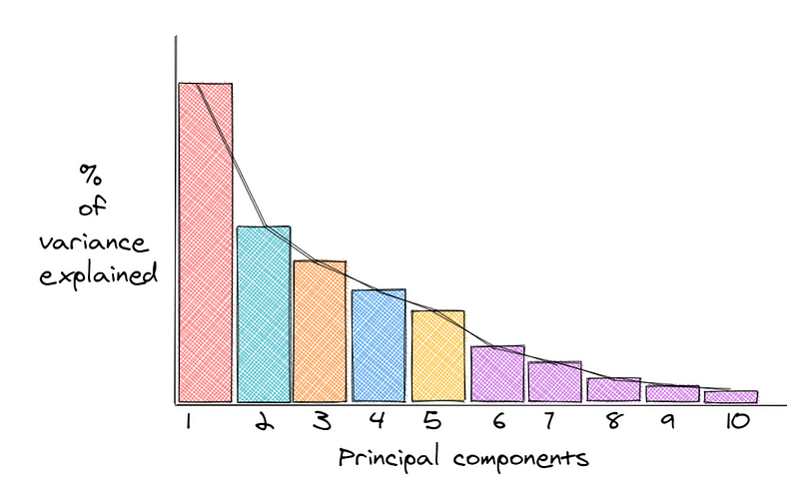
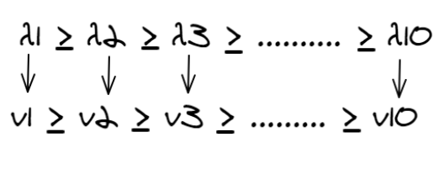

Sort by Eigen Values and Choosing Principal Components

Slide 14
Sort by Eigen Values and Choosing Principal Components
Principal components are the new variables we get as a result of the combinations or mixture of the initial variables.
Eigenvectors are usually multiplied by your original dataset to get principal components
Eigenvectors with the lowest eigenvalues contain the least information about the distribution of the data, and those are the ones we would ideally drop.
So if out of say 3 eigenvalues and you take the top two highest values, then you would end up with 2 dimensions of your dataset.
Once you decide on the eigenvalues, you now multiply the original data to the corresponding eigenvectors to get principal components.
If you had age, height, and weight for instance contributing to obesity, if weight and height have the highest eigenvalues, then you will drop age having the lowest eigenvalue.
You will then take the eigenvectors of weight and height and you would get the principal components.
These will be the new features in your dataset

Slide 15
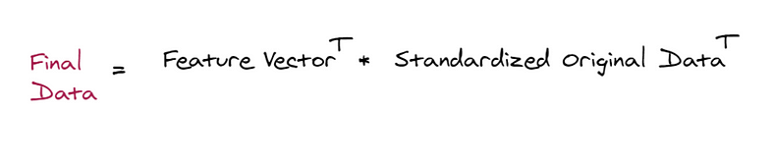
Align/ Recast data along Principal component

Slide 16
When to use PCA
When you want to reduce the number of your variables but are not able to clearly identify the variables you want to remove.
When you want to make sure your variables are independent of each other.

Slide 17
References
https://medium.com/@aptrishu/understanding-principle-component-analysis-e32be0253ef0 https://medium.com/mlearning-ai/principal-component-analysis-pca-simplified-22ef97b0e1dc https://medium.com/all-about-ml/understanding-principal-component-analysis-pca-556778324b0e Problem :
https://www.geeksforgeeks.org/mathematical-approach-to-pca/
https://www.vtupulse.com/machine-learning/principal-component-analysis-solved-example/

Slide 18
Thank you

